Slide 1
Weekly Report
Shuo Zhang & Prof. Huang

Slide 2
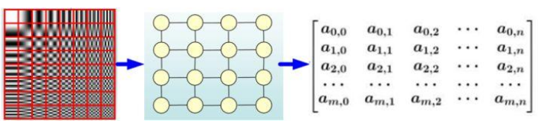
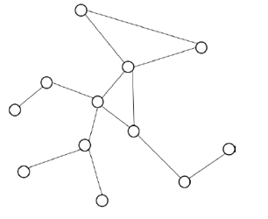
Graph Neural Network
Euclidean Structure Data
Non-Euclidean Structure Data

Slide 3

Graph Neural Network
Given a graph G, x_{v} represents the feature of node v, x_{(v, u)} represents the feature of edge connecting v and u, h_{v} is the hidden state of each node.
Our goal is to obtain h of each node by iteratively updating the hidden state of all the nodes.
At t+1 timestamp, we define the hidden state of v as:

Slide 4
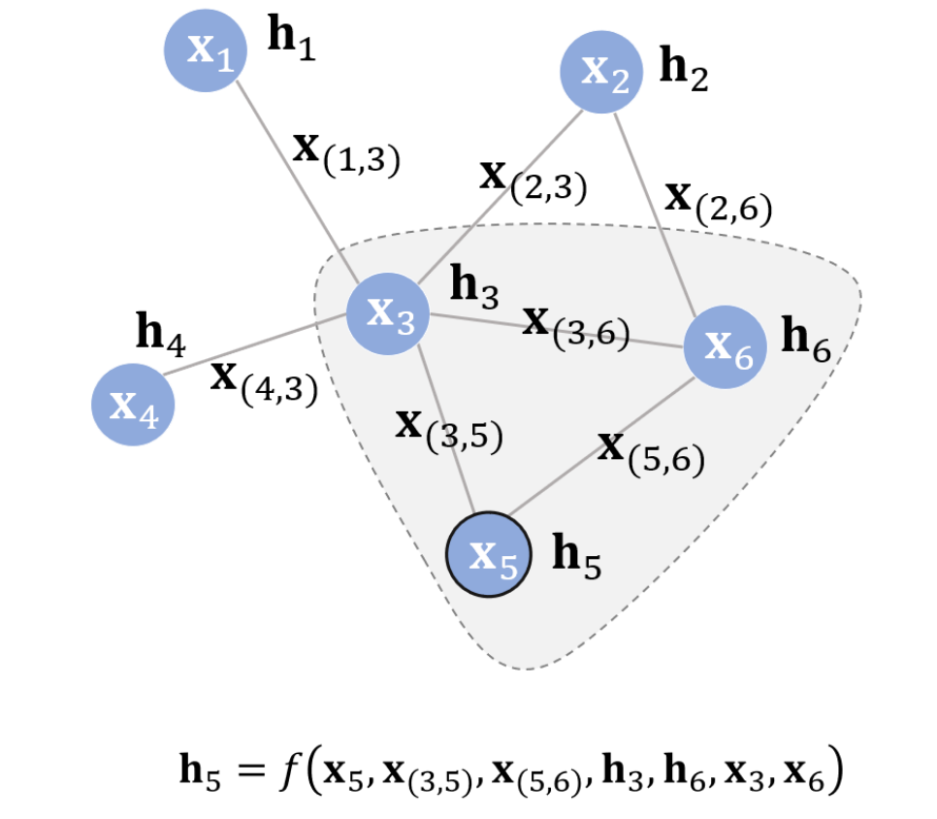
Graph Neural Network

Slide 5

Graph Neural Network
We define function f as local transaction function, which is share by all the nodes. The goal of GNN is to learn the proper representation of function f.
Besides, we define function g as local output function to do the downstream implement tasks.

Slide 6
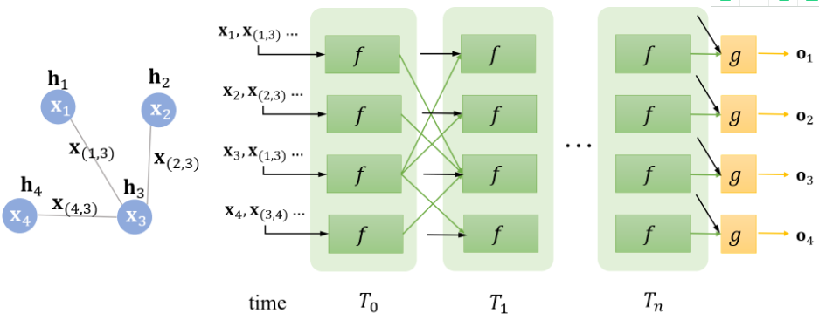
Graph Neural Network

Slide 7

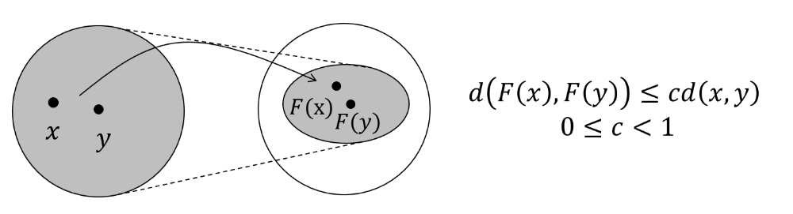
Graph Neural Network
Banach’s Fixed Point Theorem

Slide 8
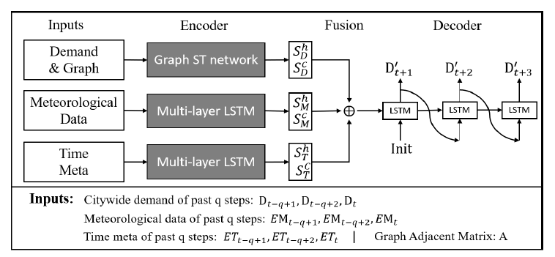
Graph Convolution Network
Spatio-Temporal Graph Convolution and Recurrent Networks for Citywide Passenger Demand Prediction, CIKM, 2019

Slide 9
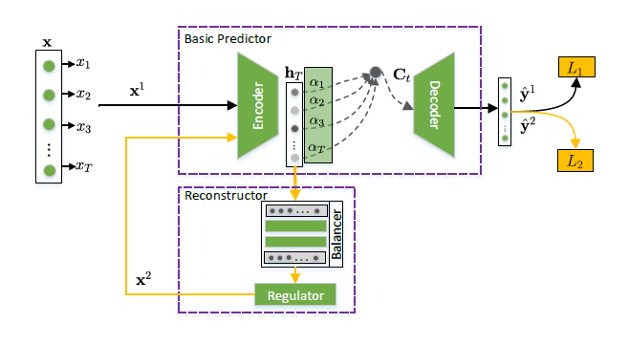
Graph Convolution Network
Time Series Prediction with Interpretable Data Reconstruction, CIKM, 2019

Slide 10
Thanks
@MICC

